Slide 1
Biochemical Circuits
Notes:
Biochemical Circuits are genetic circuits, and like the transcriptional circuits they exhibit intricate dynamic behavior. The distinguishing quality of these circuits is the inclusion of post-transcriptional processes such as protein-protein interactions.

Slide 2
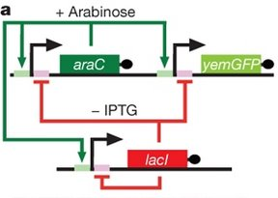
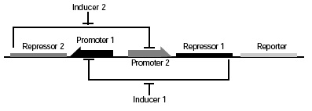
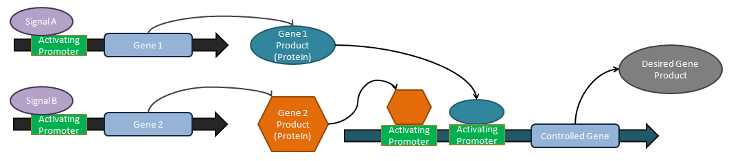
Different types of circuits
Toggle switch
PMID: 10659857
Repressilator
PMID: 10659856
Notes:
We’ve talked previously about transcription circuits such as Inverters, Toggle Switches, and Repressilators. And we saw how these circuits are composed of transcriptional repressors and the promoters they control. For these simple circuits, only one transcription factor acts on any one of the promoters, and the only difference from one circuit to the next is the number of repressors and which ones are put behind which promoters.
*
There are also more complicated circuits that involve more transcription factors, such as Activators, or involve the convergence of several transcription factors on one promoter. Here we illustrate an OR gate architecture composed of two input promoters that each drive expression of an activator, and either activator induces transcription from the output promoter. To model this more complicated case, we would need to deal with a few more states in our binding polynomial, but otherwise the model for this system is no different than for any other transcriptional circuit.

Slide 3
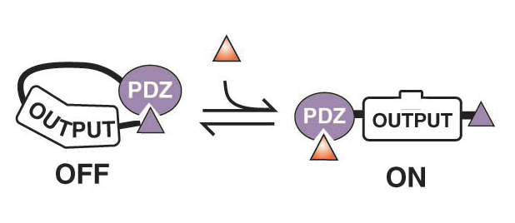
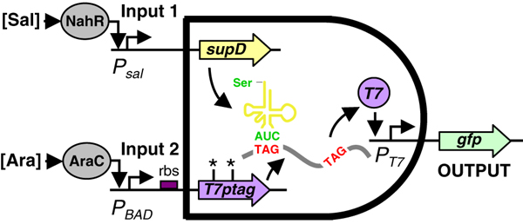
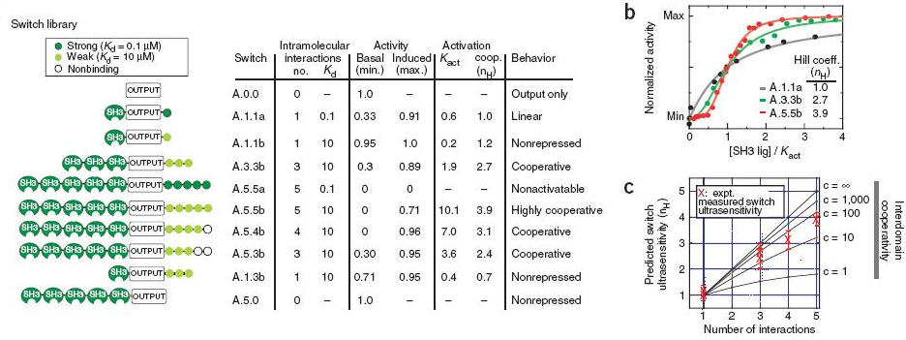
Different types of circuits
Some genetic circuits involve other types of biochemical components that interact without directly affecting transcription
They require additional considerations for modeling beyond Shea-Ackers
Allosteric signaling switches
PMID: 14512628
Transcriptional AND gate
PMID: 17700541
Ultransensitive switches
PMID: 17515908
Notes:
Other genetic circuits exploit additional biochemical mechanisms. For example, the transcriptional AND gate employs a suppressor tRNA which causes nonsense suppression of stop codons in a T7 RNA polymerase gene. To model such a system, you would need to describe this suppression phenomenon in the terms corresponding to translation elongation.
*
This genetic circuit by Dueber and Lim isn’t a transcriptional circuit at all – it controls polymerization of Actin. The ‘output’ protein, N-WASP was engineered as a fusion protein to a PDZ domain and the peptide it specifically binds. The intramolecular binding reaction between the two domains inhibits normal N-WASP function. By adding the peptide in trans, some of these fusion proteins become activated and cause actin polymerization.
*
By inserting multiple PDZ domains into the protein, they can increasing the cooperatively of the circuit. A system like this can also be modeled with differential equations, just not the specific formulation of Shea-Ackers.

Slide 4
Why do biochemical circuits?
Proteins have switch times that are faster than transcription/translation
Electrical (voltage-gated channels)
Scaffolded phosphorylation cascades
Small molecule signaling (secondary messengers)
Soluble protein-protein interactions
Translational control
Transcriptional control
DNA modification
SPEED
Since DNA is often at low concentrations, it is noise sensitive
Incorporating biochemical circuits can buffer out that noise since they involve high-concentration intermediates
Some biochemical motifs can increase the sensitivity of a circuit
Can allow for crosstalk between devices in a cell
Notes:
There are many reasons why you might want to exploit biochemical circuits instead of simple transcriptional circuits in your designs. Intramolecular interactions are typically orders of magnitude faster than the processes of transcription and translation. Sequentially building up an mRNA and protein involves thousands of enzymatic reactions, so it’s intrinsically a slow process to affect systems in this way.
*
We can describe a hierarchy of signaling timescales. The slowest ones are DNA modification, transcriptional, and translational control. These require proteins to turn over, so they typically occur on the multiple minutes timescale or slower. Protein protein interactions, small molecule signaling, and phosphorylation cascades happen on the timescale of many microseconds to seconds. The fastest responses involve the opening of channels associated with ion gradients and the electrical responses they confer.
*
Another reason to use biochemical components in a design is to buffer out noise. If we’re talking E. coli, there are between 1 and 2 copies of the genome typically present in each cell during normal growth. Expression from that 1.5 copies of a gene is necessarily noisy due to the stochastic nature of small numbers of molecules. Proteins are typically in the ballpark of 1000 molecules per cell, thus they operate more within a mass action kinetics regime. *click* If switching happens more due to the action of these more numerous molecules, more consistent responses result because the stochastic reactions all average out.
*
Biochemical components can alter the sensitivity of the circuit, and we’ll discuss two examples of this later.
*
Finally, biochemical components can allow for crosstalk between devices in a cell for more complex functionality than is achieved with transcriptional control alone. The challenge with biochemical circuits is that they rely on intermolecular interactions rather than simple rules of fusing together promoters with coding sequences. Nevertheless, it is often possible to reuse existing interacting molecules in a new context and achieve some of these benefits.

Slide 5
Sensors, Processors, and Actuators
Notes:
One of the more powerful things you can do with transcription circuits is separate responsive behaviors into distinct sensor, processor, and actuator devices.

Slide 6
Extensibility of inputs/outputs
Transcriptional signals are modularity points in the decomposition of a biological activity
Sensor devices are environment in / common signal carrier out
Signal Processors
Sensors
Actuators
Sensors
GFP
Notes:
Transcriptional signals are useful modularity points in the retrosynthetic analysis of a biological activity. Their value is that no specific biochemical interactions are needed for two unrelated processes to become coupled. Connecting a sensor and an actuator only involves joining of a promoter with a downstream coding sequence, without any additional interactions between the two processes. Basically, any promoter can be put in front of any coding sequence.
*
Thus, we can categorize different devices in terms of whether they input or output transcriptional signals and from this derive the potential combinations of devices into larger devices. A sensor is something that inputs an environmental signal and drives output expression in response. Inducible promoters are simple examples of sensor devices. You typically characterize the function of a sensor device by fusing it to GFP and monitoring GFP as some function of the environmental signal.

Slide 7
Extensibility of inputs/outputs
Transcriptional signals are modularity points in the decomposition of a biological activity
Sensor devices are environment in / common signal carrier out
Actuator devices are common signal carrier in / behavior out
Signal Processors
Sensors
Actuators
Pbad
Actuators
Notes:
Actuators are devices that input a transcriptional signal and output some non-transcriptional behavior. That would include an operon encoding a biosynthetic pathway, or perhaps proteinaceous appendages to the cell’s surface. You typically characterize an actuator by placing under the control of a simple inducible promoter, such as Pbad, and monitoring some measure of the output behavior as a function of inducer concentration. For example, if your sensor was a Pbad promoter and you have it driving an actuator that is a biosynthetic pathway for violacein, you might vary arabinose concentration and monitoring purple color, or you might quantify violacein by LC-MS assays.

Slide 8
Extensibility of inputs/outputs
Transcriptional signals are modularity points in the decomposition of a biological activity
Sensor devices are environment in / common signal carrier out
Actuator devices are common signal carrier in / behavior out
Processing devices are common signal carrier in and out
Signal Processors
Sensors
Actuators
Signal Processors
Pbad
GFP
Notes:
Finally there are signal processors which input transcription and output transcription. Inverters are examples of signal processors with a single input and single output. Various logic gates are also signal processors with multiple transcriptional inputs and a single transcriptional output. You typically characterize a signal processor by sandwiching it in between an inducible promoter and an output fluorescent protein reporter, and then monitoring fluorescence as a function of inducer.

Slide 9
Extensibility of inputs/outputs
Common signal carriers are modularity points in the decomposition of a biological activity
There are only 3 extensible common signal carriers that have been described: translational control, transcriptional control, and physical association
Sensor devices are environment in / common signal carrier out
Actuator devices are common signal carrier in / behavior out
Processing devices are common signal carrier in and out
There isn’t really a name for a circuit that is environment in / behavior out, but you can only characterize these more complex devices
Pbad
inverter
GFP
Notes:
There isn’t really a name for a circuit that is environment in / behavior out, but it is buildable and with a little tuning it is usually possible to have the function of all three components manifested in the complete system. Here we illustrate a trivial combination of one from each class: the sensor Pbad drives transcription of the input promoter for an inverter, which drives expression of GFP. If we get the ribosome binding sites all turned correctly, this device responds to increasing environmental concentrations of arabinose with decreasing fluorescense.

Slide 10
Extensibility of inputs/outputs
Common signal carriers are modularity points in the decomposition of a biological activity
There are only 3 extensible common signal carriers that have been described: translational control, transcriptional control, and physical association
Sensor devices are environment in / common signal carrier out
Actuator devices are common signal carrier in / behavior out
Processing devices are common signal carrier in and out
There isn’t really a name for a circuit that is environment in / behavior out, but you can only characterize these more complex devices
Nevertheless, you can tell by inspection whether a circuit has extensible substructure or not
You should be able to readily recognize which type of device you are looking at based on the circuit diagram
Notes:
You can tell by inspection whether a circuit has extensible substructure or not. The question you will likely at some point need to ask yourself is, How do I know if I can employ Bob’s ultrasensitive switch in my application? You should be able to readily recognize whether you are looking at a sensor, actuator, or processor by inspection of the circuit diagram. From this you can readily judge its ability to be modified for use in a more complicated design.

Slide 11
Extensibility of inputs/outputs
Toggle switch
PMID: 10659857
Input: No
Output: Transcription
Notes:
Let’s try some examples. Here is the toggle switch. The question we need to ask ourselves is whether there is a place in the DNA where we can cut out some ‘output’ gene and swap in GFP. Also, can we swap out some sensor and put in Pbad. The reporter in the toggle switch is already transcription of GFP, so we can already rule out actuator. The two encoded proteins seem highly tied to their specific promoters. I can’t for example, replace the Ptet promoter and swap in Pbad. So, at least as drawn, the toggle switch isn’t actually a processor, it would be a sensor. It responds to environmental stimuli which are the small molecules anhydrotetracycline and IPTG. It is possible to modify the circuit by adding a second gene that placed one of the repressors under Pbad, and from this you can turn the toggle switch into a processor. Actually, in all cases you can add a copy of any protein component, and you control its behavior by controlling its promoter, and thus you end up with a processor. However, you would have to re-inspect the model carefully to make sure it still displays the same behavior with the added reactions. Some circuits will retain their original behavior and others won’t. This one will still contain the bistability behavior with, say, a Pbad-tetR constract added. However, the ‘turn on/turn off’ description of the behavior stops being appropriate. It becomes something more appropriately described as a bistable ultrasensitive switch.

Slide 12
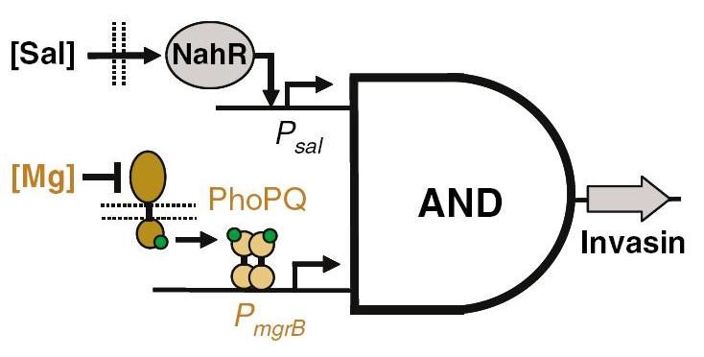
Extensibility of inputs/outputs
Invasin AND gate
PMID: 17700541
Input: Transcription
Output: Transcription
Notes:
Here’s one I did when I was a postdoc. The inner guts of the AND gate involve a suppressor tRNA under the Psal promoter, and a T7-RNA polymerase under the mgrB promoter. The output is a T7 promoter driving invasin. As shown, it is drawn as a processor, and indeed the inputs and outputs are exchangeable. It is a two input/one output processor, but a processor nonetheless. The two inputs in this circuit are Psal and mrgB, but those can be exchanged for, say, the luciferase luxI promoter and Pbad. Similarly, I can exchange the output from invasin to GFP, and I would not need to re-write my model and analysis. It would still clearly be an AND gate obeying the equations of the original model.

Slide 13
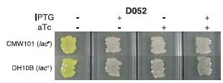
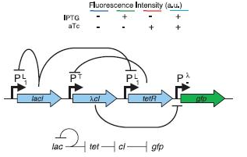
Extensibility of inputs/outputs
Input: No
Output: Transcription
NOR gate
PMID: 12029133
Notes:
Here’s another genetic circuit that is actually a sensor but looks a little like a processor. It has the same general architecture as the repressilator, but slightly different connectivity. It uses the same three reressors, but lacI inhibits its own synthesis as well as tetR. Ptet controls cI, and cI controls the output promoter. So, I can exchange GFP for any other actuator under the lambda promoter, and I won’t change the behavior of the circuit. There is no place where I can add in a Pbad promoter without disrupting the basic wiring of the circuit. I can add a second repressor such as Pbad-tetR, but that’s not going to transfer this logic behavior onto the promoter.
*
Different genetic circuits are heterogeneous in terms of the nature of their inputs and outputs. In many cases such as this one, the inputs are necessarily specific chemicals instead of extensible signal carriers. So, sometimes there is modular reuse of a genetic circuit, but other times the circuit cannot be expanded upon.

Slide 14
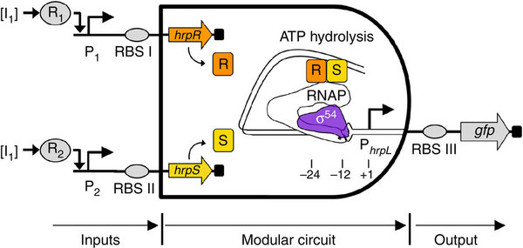
Is this a transcriptional sensor, actuator, or processor?
http://www.nature.com/ncomms/journal/v2/n10/full/ncomms1516.html

Slide 15
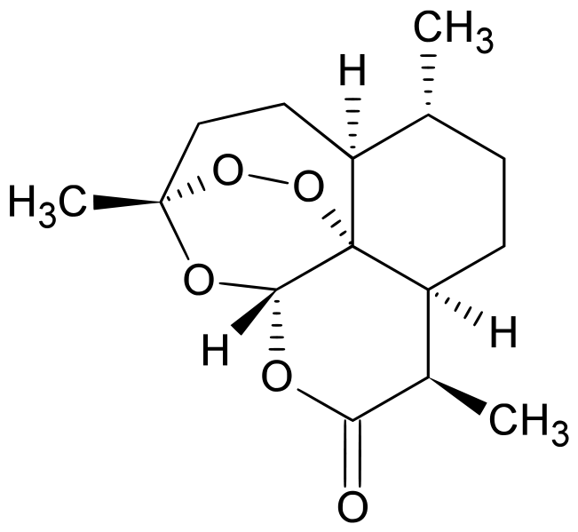
Is this a transcriptional sensor, actuator, or processor?
atoB
HMGS
tHMGR
MK
PMK
MPD
idi
ispA
ADS
AMO
CPR
A Biosynthetic Device

Slide 16
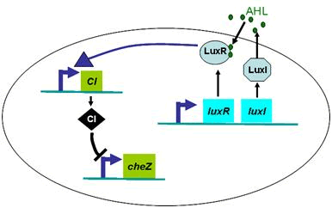
Is this a transcriptional sensor, actuator, or processor?
http://2008.igem.org/Team:iHKU/modelling

Slide 17
Is this a transcriptional sensor, actuator, or processor?

Slide 18
Threshold-Gating
Notes:
In threshold-gating, a competitive protein binding interaction modifies the response behavior of a genetic circuit.

Slide 19
The threshold-gated motif
Notes:
Suppose there is a promoter, shown as the blue arrow which is controlling the expression of some gene in pink. There is also a transcription factor, in blue that acts upon the promoter. In the example we’ll discuss the blue transcription factor is an activator, but the general point of threshold-gating applies to either activators or repressors. So, if there is some amount of the blue protein present it would cause activation, and we could express the fractional activation with an KaA/(1+KaA) term. Furthermore, let’s consider the extreme case in which the binding is sub-nanomolar and thus the DNA titrates out the activator. Thus, I illustrate that activator as bound to the promoter and causing transcription initiation.
*
Now consider that I add a second green gene encoding a protein that inhibits and sequesters the activator. Assuming that it binds very tightly and its concentration exceeds that of the activator, then it will titrate out all the activator into these non-functional complexes. Thus, there isn’t much activator around to bind to the promoter, and it goes unoccupied.
*
Finally consider that we add a little more activator such that it is more concentrated than the inhibitor, and thus the free activators can bind to the promoter and initiate transcription. Thus, as you ramp up the amount of activator output transcription is zero until some threshold is reached and then transcription jumps dramatically with a relatively small addition of activator.

Slide 20
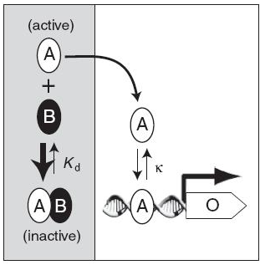
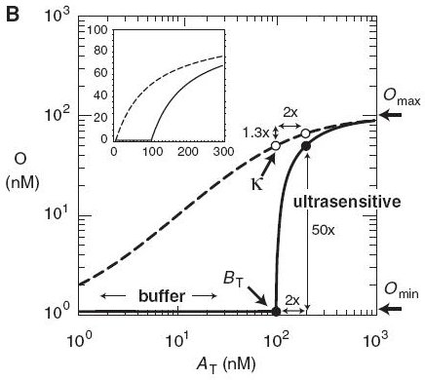
The threshold-gated motif
Including a constitutively-expressed inhibitor into a circuit will increase the sharpness of the response
Threshold-gated transcription
PMID 19455136
Notes:
In this paper by Cross and cowerks they use this threshold-gating motif to construct a genetic circuit. At left here, they illustrate that the activator activates some promoter but A can also participate in complex formation. At right, the dotted line is the predicted response of their circuit without the competing sequestration reaction, and the solid line shows what happens if the inhibitor is present. Adding the inhibitor has two effects: first, it results in a high-pass filter in which weak signals are attenuated and only strong signals result in responses. Second, the switch becomes ultrasensitive and switches from off to on under a narrow range of values.

Slide 21
The threshold-gated motif
Solve the equilibrium expression for A
Substitute in At-A for AB
Substitute Bt – AB = Bt – (At-A) for B
Then solve for A using the quadratic equation:
Can combine that with a Shea-Ackers model of the circuit
Notes:
Let’s do some math. This first equation is derived from the equilibrium expression Kd = A times B over AB complex. The total amount of A, A total, is equal the amount of free A plus the amount of AB complex. Similarly, total B is equal to free B plus AB complex.
*
I won’t derive it in detail, but what you do is first solve the equilibrium for A, then substitute in Atotal minus A for AB, then substitute in for B, and finally you can solve that for A using the
*
Quadratic equation. This is an expression for free A. In Shea-Ackers we describe the fraction of the promoters active for transcription as Ka*A over (1+KaA), so we could substitute this expression for A into that and get an appropriate model for the system. That would be ugly, but that derivation will deal with the edge cases where the binding interactions are moderate in strength.

Slide 22
The threshold-gated motif simplified
An activated promoter with a constitutive background:
If you assume that A and B bind tightly, the math simplifies:
» 1
Notes:
Instead, the authors do some simplifying math. They model the transcription rate as some constant rate Omin + Omax*A/A+k. This looks a little different than our Shea Ackers math, but its very similar. If we derive our Shea-Ackers model and include a basal transcription rate for the promoter in the absense of A and we also assume that degradation is zeroth order, then we’ll get this equation.
*
They’ll assume that A and B bind tightly to one another. This is equivalent to saying that Btotal divided by Kd is much greater than 1. If this is the case, then the system can be modeled with two equations. When Atotal is less than Btotal, the transcription rate is the Omin rate. When A total exceeds Btotal, then we use the A/A+K expression substiting in Atotal-Btotal for A.

Slide 23
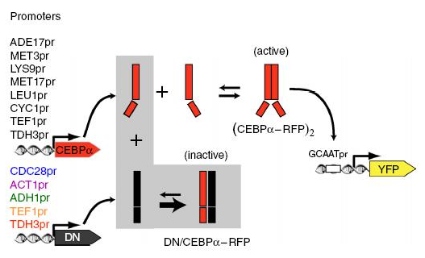
The threshold-gated motif
Threshold-gated transcription
19455136
Notes:
They experimentally test the math in yeast. They construct two genes. The CEBPalpha gene is the activator, and DN is the inhibitor. They examine different promoters for each construct to scan the parameter space. If the activator is active, it causes YFP expression from a downstream reporter.

Slide 24
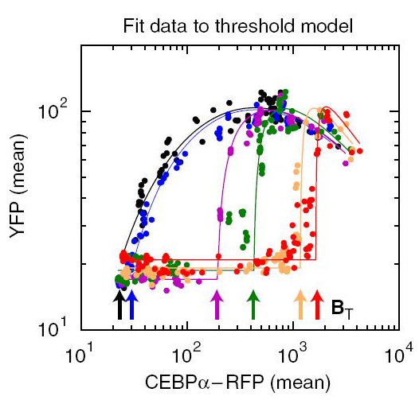
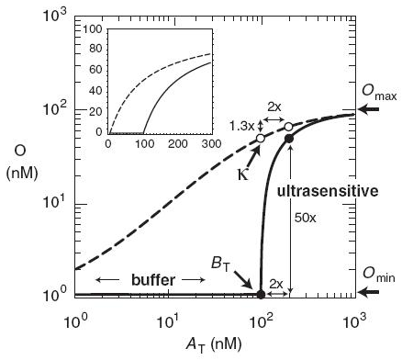
The threshold-gated motif
Notes:
Experimentally, the observed data looks quite similar to the model. Each colored line represents a different strength promoter on the inhibitor DN. For weaker promoters, the system has the slow and graded response of the inhibitor-free model. As the promoters get stronger, the more inhibitor is present which shifts the response towards the right by soaking up activator. At the higher promoter strengths, ultrasensitivity is clearly present.

Slide 25
Split-Components
Notes:
Like the threshold-gating motif, the split-component motif is used to modify the response of a genetic circuit. It deals with the scenario in which a model component is replaced with a heterodimer.

Slide 26
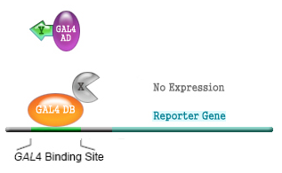
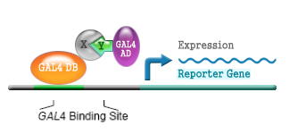
The split-component motif
A two-hybrid system is an example of the split-component motif
a transcriptional activator is split into two proteins that interact through a protein-protein interaction to get activation
Can always (at least imagine) splitting any soluble component of a genetic circuit into two proteins interacting by a protein-protein interaction
Notes:
The system to think about when thinking about split components is the two hybrid system.
*
In this yeast circuit, a transcriptional activator is split into two proteins that interact through a protein-protein interaction to get activation. The DB subunit of the transcriptionally activating heterodimer binds the DNA, and the other subunit, AD, recruits the polymerase. DB is referred to as the bait and AD as the prey. The interaction between AD and DB is controlled by a pairing of fused proteins designated X and Y in the figure.
*
Everything we say about the two-hybrid circuit would apply to the scenario in which the activator is split into two genes. It also does not need to be an activator, and for that matter it doesn’t even need to be a transcriptional signal. The split-component motif applies to any scenario in which you split a soluble component into two components that work in concert.

Slide 27






Modeling the two-hybrid system
Since BP (the bait/prey complex) is the active species, you want to express BP to write out the Shea-Ackers partition function
Can also include total bait “Bait” and total prey “Prey” terms since those are going to fit in with the Shea-Ackers equations describing their own production
Ka
Ka
Ka
…then solve that for BP, which is messy, but can then substitute that into Shea-Ackers to get an expression based on Bait, Prey, and Ka (or Kd):
Notes:
Since BP is the activating species, we need to get an expression for the amount of protein in this complexation state. We write out the chemical reaction and the equilibrium expression that Ka equals BP over B times P.
*
We can also get an expression for total bait and total prey as the sum of the free species plus the complex.
*
We can then substitute these in to get an expression that eliminates the free B and free P terms.
*
We would then solve that equation for BP, which will be messy, then substitute that into an expression based on total bait, total prey, and a binding constant for the promoter. If we also write differential equations describing the formation of bait and prey protein (the total bait and total prey) we have a complete set to describe the system.

Slide 28


Modeling the two-hybrid system
You can go through and consider the scenario where binding constant isn’t all that tight and you’ll get a more complicated answer
PMID 17557786 assumes that binding is effectively stoichiometric
It also considers the scenario in which there is cross-reactivity with other components in the cell that compete with bait/prey interactions or the scenario where the bait itself induces activation
When Prey > Bait
When Prey < Bait
Notes:
That is the math we need to do if the binding constants aren’t that tight, and it will be messy. However, if you really want to be this accurate with your modeling you will be doing everything numerically, so let’s make some simplifying assumptions.
*
In this paper, they will assume that the binding is very tight and thus bait and prey stoichiometrically titrate each other out.
*
They also consider the scenario in which there is cross-reactivity with other competing components in the cell
*
If we assume that we are only going to deal with orthogonal components and tight binding, this all becomes fairly simple. When the prey concentration is higher than bait, all the bait is in the form of bait:prey complex and thus our fraction of open promoters can be expressed in terms of only the bait. When the prey concentration is less than the bait, then the amount of functional complex is the total prey concentration. In derivation of the binding polynomial, the total amount of protein is given by the total amount of bait.

Slide 29
Modeling the two-hybrid system
Transfer function shown below for scenario in which P is constitutively expressed
Get a leveling effect which caps the amount of activity that can come out of the system
Activator alone
(constitutively active bait)
M
Bait + Prey
Bait
Notes:
Here we plot out the transfer function that relates an input bait concentration with the output response. If you exclude the prey and consider the scenario of a single activator, you get the blue line which follows the typical slow and graded response. When you include the prey in the model, it follows the same curve as the activator system until bait and prey reach the same concentration. After this, no more activating complex can be formed, so no higher signal is achieved, but each added bait molecule competes with the Bait:Prey complex for promoter binding thus slowly decreasing the signal over time. Thus, there is an optimal expression to the system in which bait and prey concentrations are equal, but there is also a leveling effect that keeps the system at a similar expression level. Quite unlike the ultrasensitive threshold-gated motif, the split-component motif is quite insensitive.

Slide 30
Transfer Functions
Notes:
Transfer functions describe the input to output relationship of a biological process. They are most frequently encountered in the context of genetic circuits such as logic gates and environmental sensors.

Slide 31
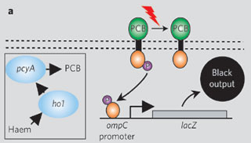
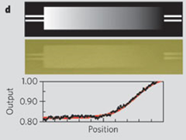
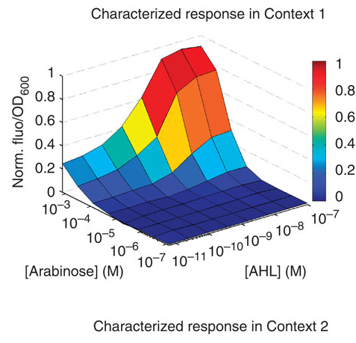
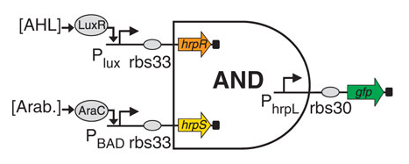
What is a transfer function?
Notes:
We described a clade of genetic circuits that involve the joining of sensors, processors, and actuators. All of these involved transcriptional inputs or outputs, and it will be useful to mathematically relate these variables. When people speak of ‘characterizing a device’ they generally are referring to the experimental measurement of an environmental input and the cell’s response. For example, the light sensor from Voigt and coworkers involves a histidine kinase cascade that responds to light and outputs transcription. Controlled amounts of light can be provided using a lamp and mask, and transcription can be monitored by fusing the output promoter to a reporter gene such as lacZ. In the figure at right, they place a graded mask over the bacterial culture allowing a gradient of light over the bacteria. By measuring the color formation in the cells, they can describe the transfer function relating transcription output to incoming light signal.
*
Similarly, a genetic AND gate such as this one would be characterized by a transfer function that maps input transcription to output transcription. Typically, this is done by varying the concentration of an inducer with a known relationship to transcript level, and is monitored by GFP formation as an indirect measure of output transcription.
When we characterize an existing device, we find out what it really does. However, when we want to design a device we need some way of predicting what the circuit will do. I’ll walk you through an example derivation so you see how this works.

Slide 32


Transfer function derivation
Inducer
gfp
Notes:
The transfer function is specific to the inner workings of your genetic circuit and can be derived from the differential equation model. So, step one in deriving the transfer function is to inspect the diagram and write out differential equations. Here we are considering some inducible promoter. The detailed differential equation model describing the inner workings of any specific inducible promoter would depend on additional factors such as the amount of repressor and any other states of the promoter. However, let’s keep this simple for discussion. Let’s assume that this *click* simple ‘activator’ model captures the behavior of the circuit. We say that the GFP protein (or GFP mRNA) changes with time by a production term involving a binding equilibrium, and a degradation term first order with respect to GFP. This is exactly what we described with the Shea-Ackers model for a promoter under the control of an activator protein with a constitutive background. Regardless of what you write out for the differential equation, the rest of the analysis is decoupled from the details of the equation. You will make a steady state assumption, set this differential equation equal to zero, and then solve for G
*
And what you get is an expression for G in the steady state as a function of inducer concentrations and variatious rate and equilibrium constants. You can thus examine what will happen to G as a function of any of these variables. If you examine G as a function of k, you’d see that is linearly related to this maximal transcription rate. Similarly, if you examine G as a function of I you’d see that it follows a normal saturation binding curve.
Deriving the transfer function is a simple extension of the modeling we have discussed based on differential equations. It is a useful analysis when you wish to predict how your system will respond to any changes in paramaters that you might choose to vary.

Slide 33
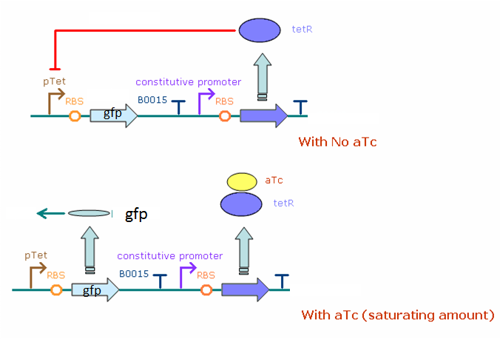
Derive the transfer function for the following:

